Slide 1
Lecture 7
Stacks & Queues

Slide 2
Main Points
Implementing a Stack:
Using an array
Using a linked list
Implementing a Queue
Using an array
Using a linked list
Typical use of Stack and Queue

Slide 3
Stack
Remember:
A list in which only 2 operations are allowed Insertion & Deletion: push and pop
Components are inserted and deleted in a LIFO manner: Last In First Out
There are 2 basic stack implementations:
Using Arrays
Using Linked Lists

Slide 4
Stack as an Array
A variable ‘top’ tracks always the last element in the stack. The initial value of top is ‘-1’: the stack is empty.
The value of top should not exceed the Max, otherwise there would be an overflow
.
.
.
Element 3
Element 2
Element 1
Top

Slide 5
Stack as an Array: Implementation
Two main functions:
Element pop(){
//check if the stack is empty
//else return stack[top--];
}
push(element N){
//check if the stack is full
// else stack[++top]=N;
}

Slide 6
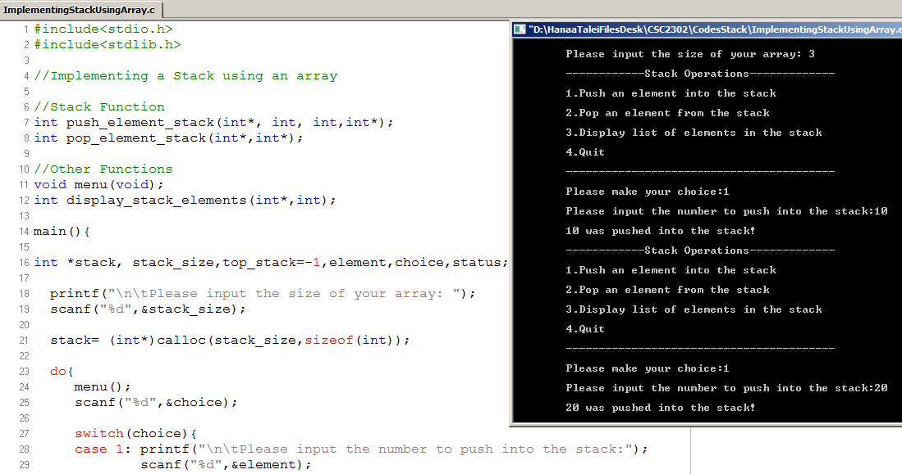
Stack :Illustration (1)

Slide 7
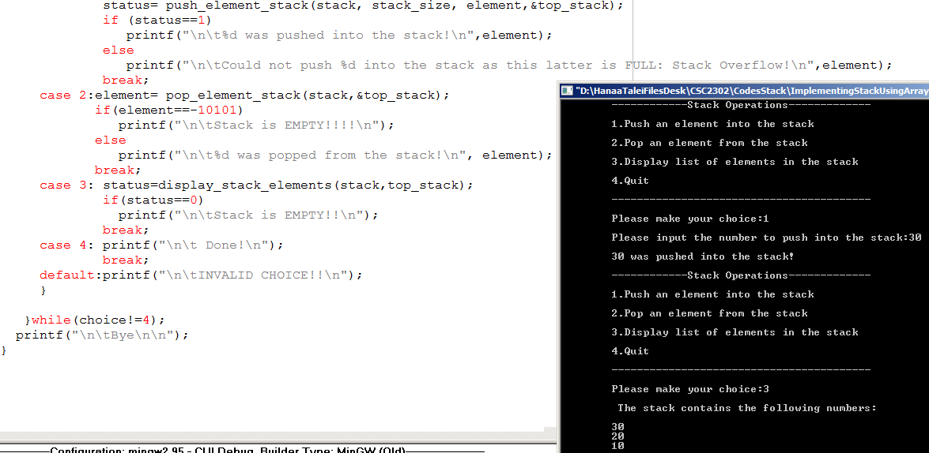
Illustration (2)

Slide 8
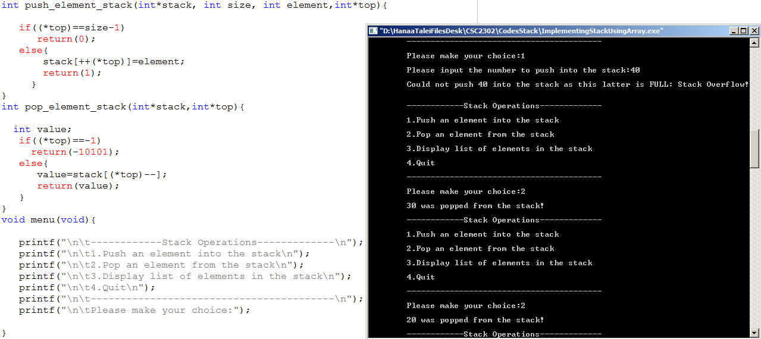
Illustration(3)

Slide 9
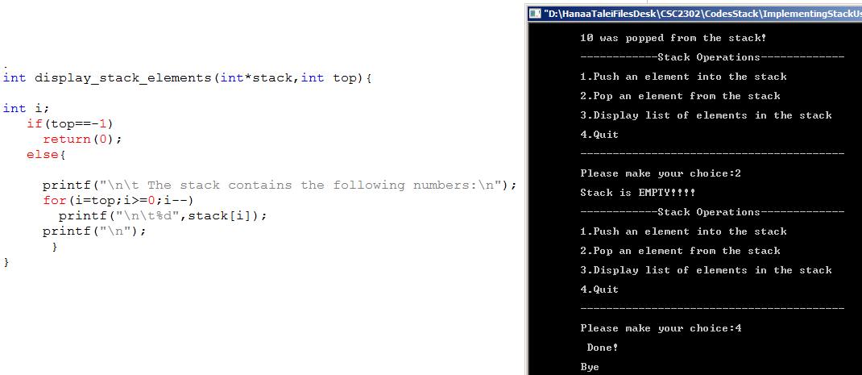

Slide 10
Time Complexity and problems!!
Popping or pushing an element from/to stack is of O(1)
Drawbacks:
the programmer has to guess the max size of the array
when elements are popped, the corresponding rooms are not freed (No dynamic memory allocation)
There is always a limit on the size of the stack
A better implementation:
Linked Lists
However, the array implementation is very suitable for small sized stacks which is usually the case.
The same time complexity for both implementations

Slide 11
Stack: Using a Linked List

Slide 12
Stack: using a Linked List
A stack can also be implemented as a Linked list in which all the insertions and deletions are performed at the list head.
The nodes that hold elements of the stack are typical linked list node structures with an information plus a pointer that points to the next node
What about the top??

Slide 13
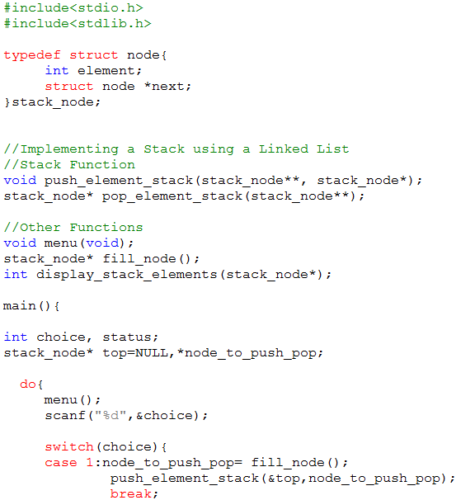
Stack of Integers using Linked List

Slide 14
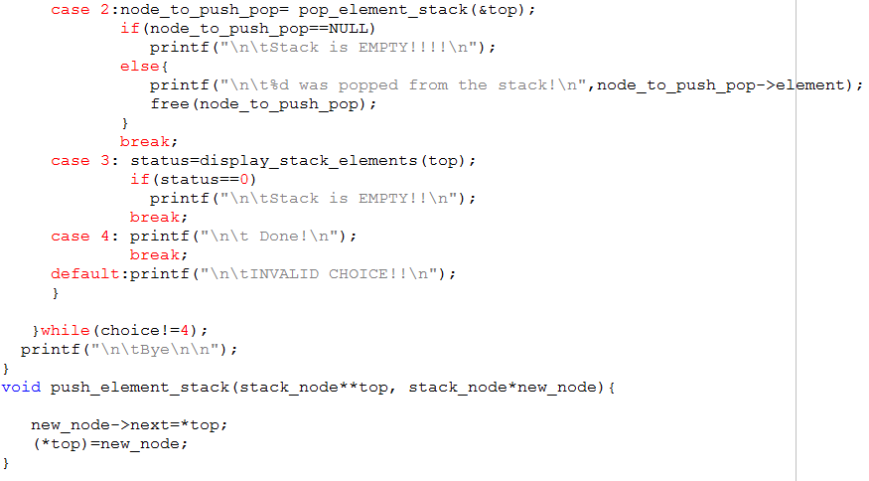
Stack of Integers using Linked List

Slide 15
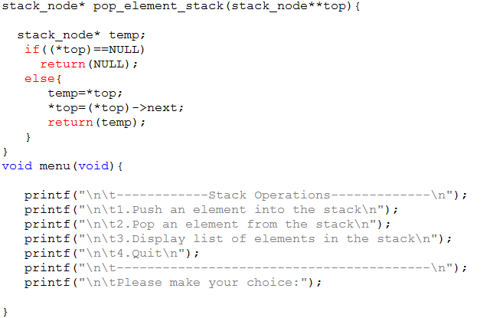
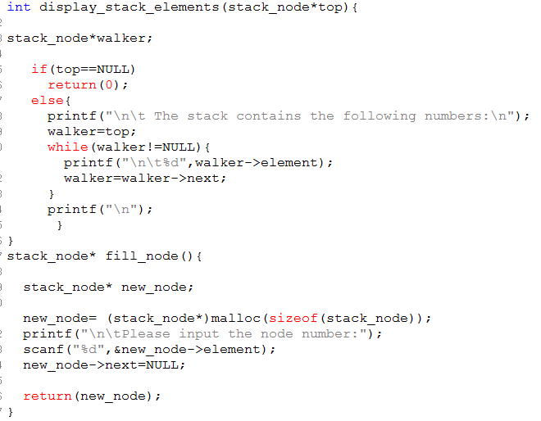

Slide 16
Typical Usage of Stacks: 1. Reversing a List
Algorithm:
Push all elements of the concerned list on a stack
Pop element by element and store on a new list

Slide 17
Typical usage of Stacks 2. Compiling Balanced parentheses
Algorithm:
Scan the characters you have:
If a character (, [ is read, push it on the stack
Else if a character ), ] is read, pop a character from the stack:
If the 2 characters are of the same type – exp.: a ‘[‘ and a ‘]’, proceed the next character
Else: The syntax is incorrect
Once the whole file is read:
If stack is empty: Correctly balanced
Else: Incorrectly balanced

Slide 18
Exercise:
Assume that you have a math expression saved in a txt file
Using a stack (implemented using an array), check whether your math expression is a balanced one or not
You should test your program for a math expression that contains parentheses ‘( )’ and brackets ‘[ ]’

Slide 19
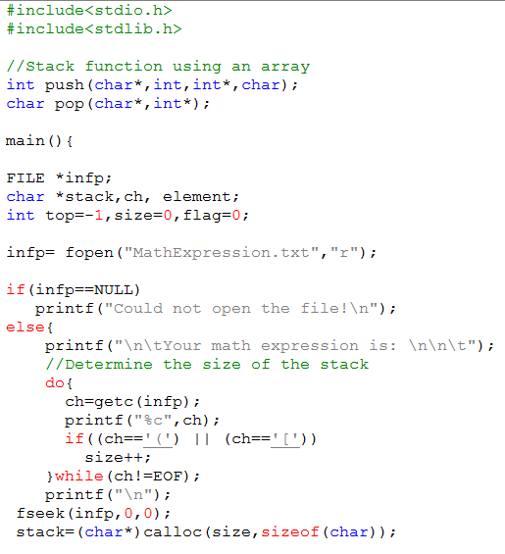
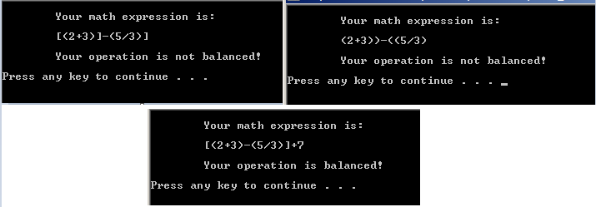

Slide 20
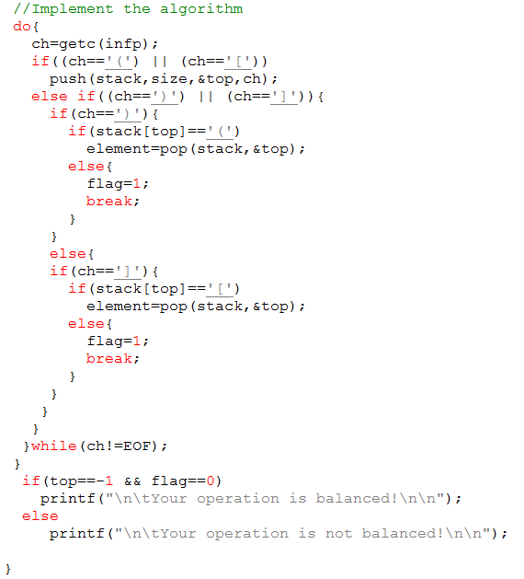
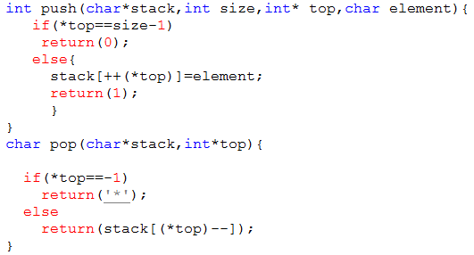

Slide 21
Typical usage of stacks 3.Postfix Notation
Usual algebraic notation is termed infix operation
Operator appears between the two operands
Infix notation may require parentheses to specify a desired order of operations
Using postfix notation, the need for parentheses is eliminated as the operator is placed directly after the two operands to which it applies
A/B+C  AB/C+
A/(B+C)  ABC+/

Slide 22
From infix to postfix
We need a systematic method for complex expressions
Algorithm:
1. Completely parenthesize the infix expression to specify the order of the operations
2. Move each operator to the space held by its corresponding right (closing) parenthesis
Remove parentheses
Refer to the next example

Slide 23
From Infix to Postfix: an example
a/b-c+d*e-a*c
Steps:
((((a/b)-c)+(d*e))-(a*c))
((ab/-c)+(de*)-(ac*))
((ab/c-+(de*))-(ac*))
((ab/c-de*+)-(ac*))
(ab/c-de*+ac*-)
ab/c-de*+ac*-
What about a+b*c/d-e/f?
abc*d/+ef/-

Slide 24
Automating Infix to Postfix Conversion: an expression without parentheses Homework, Refer to the code on portal
Scan the Infix string from left to right.
If the scanned character is an operand, add it to the Postfix string. If the scanned character is an operator and if the stack is empty Push the character to stack.
If the scanned character is an operator and the stack is not empty, compare the precedence of the character with the element on top of the stack (topStack). If topStack has higher or equal precedence over the scanned character Pop the stack else Push the scanned character to stack. Repeat this step as long as stack is not empty and topStack has precedence over the character.
After all characters are scanned, we have to add any character that the stack may have to the Postfix string. If stack is not empty add topStack to Postfix string and Pop the stack. Repeat this step as long as stack is not empty.
Refer to the next example

Slide 25
Example
We will apply the discussed algorithm above to a+b*c-d
Stack is empty and our Postfix string has no characters. The first character scanned is 'a'. 'a' is added to the Postfix string. The next character scanned is '+'. It being an operator, it is pushed to the stack.
Next character scanned is 'b' which will be placed in the Postfix string. Next character is '*' which is an operator. Now, the top element of the stack is '+' which has lower precedence than '*', so '*' will be pushed to the stack.
The next character is 'c' which is placed in the Postfix string. Next character scanned is '-'. The topmost character in the stack is '*' which has a higher precedence than '-'. Thus '*' will be popped out from the stack and added to the Postfix string. The topmost element of the stack is '+' which has equal priority to '-'. So pop the '+' from the stack and add it to the Postfix string. The '-' will be pushed to the stack.
Next character is 'd' which is added to Postfix string. Now all characters have been scanned->pop the remaining elements from the stack and add it to the Postfix string. At this stage we have only a '-' in the stack. It is popped out and added to the Postfix string.

Slide 26
Automating Infix to Postfix Conversion: expression with parenthesis
Using a stack to hold operators
Algorithm:
Read character by character:
If it is a number then write it to output
If it is a left parenthesis then push it on stack
If it is an operator:
If the top of the stack is an operator of ‘lower’ priority OR the stack is empty then push the operator on the stack
Else, as long as the stack is not empty, pop all operators from the stack – till encountering an operator of lower priority (strictly less) OR till a left parenthesis is encountered / this later should not be popped - and write them to output; then push the read operator onto stack
NB: The parenthesis is of less priority than operators
Else if it is a right parenthesis:
Pop all operators till a left parenthesis is popped and write them to the output– Do not write parentheses to output
When all characters are read, pop the remaining operators and write them to output

Slide 27
Automating the Evaluation of Postfix Expressions
Algorithm:
Read character by character
IF a number then push it on stack
Else if an operator
Pop 2 numbers from stack
Apply the operator to the 2 numbers
Push the result in the stack

Slide 28
Exercise
Write a program that reads an infix notation, displays the corresponding postfix notation, then evaluates the postfix notation

Slide 29
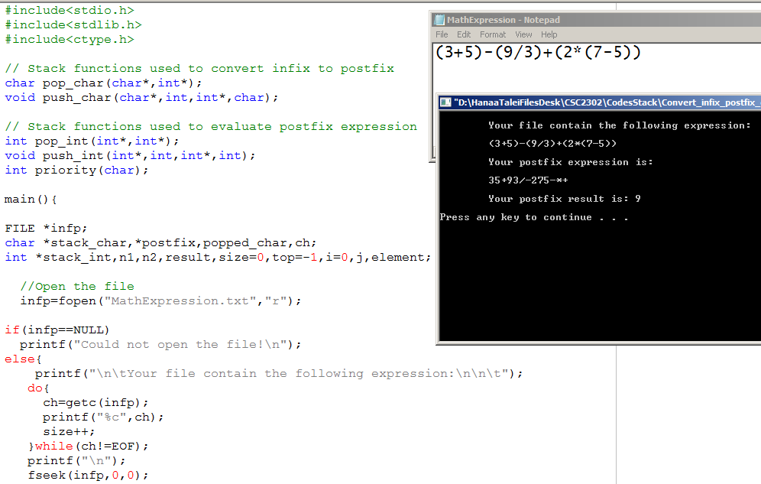
Illustration

Slide 30
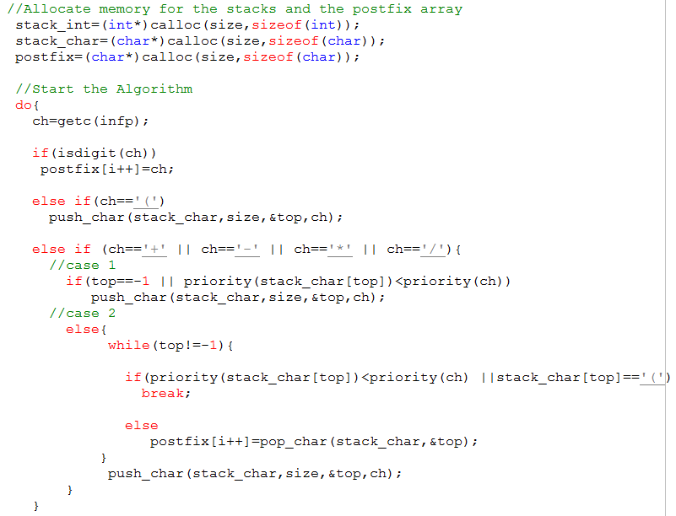

Slide 31
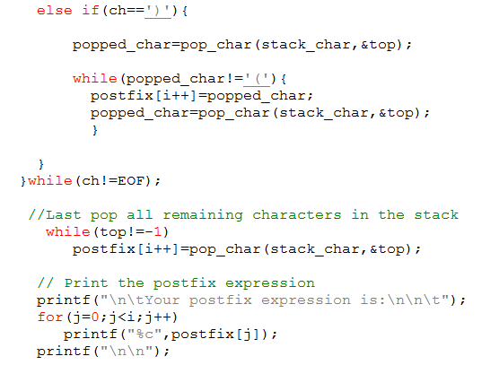
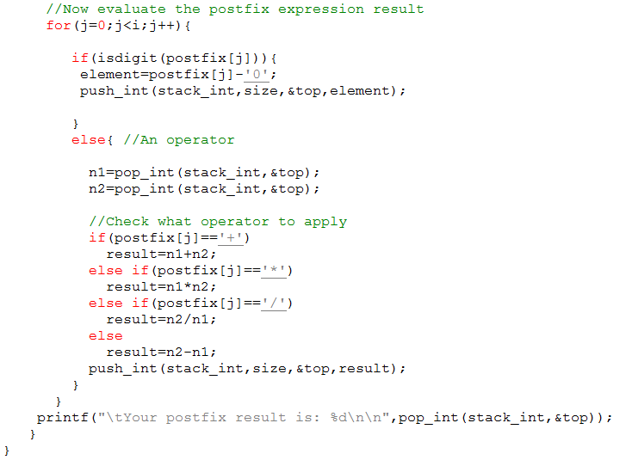

Slide 32
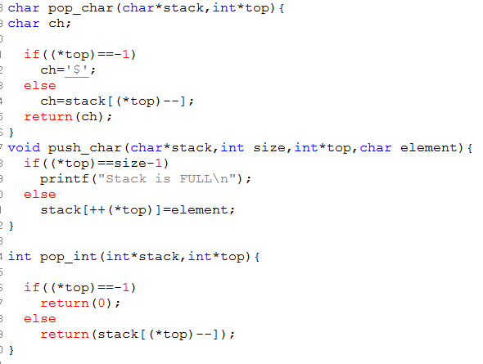
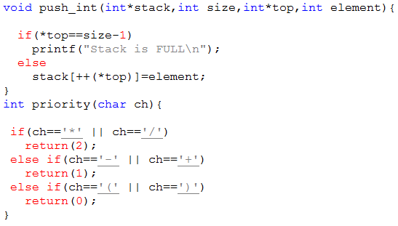

Slide 33
Queues

Slide 34
Queues
 an ADT
Elements are inserted and deleted in a FIFO (First-in, First-out) manner
2 basic implementations:
Using arrays
Using linked lists

Slide 35
Queue: implemented using an array
Void Enqueue(element E) {
//check if array is full
//else Arr[rear++] = E;
}
Element dequeue( ) {
//Check if the array is empty
//else{ return Arr[front];
//and then?
}
}
Time Complexity?
Insert/delete: O(1)

Slide 36
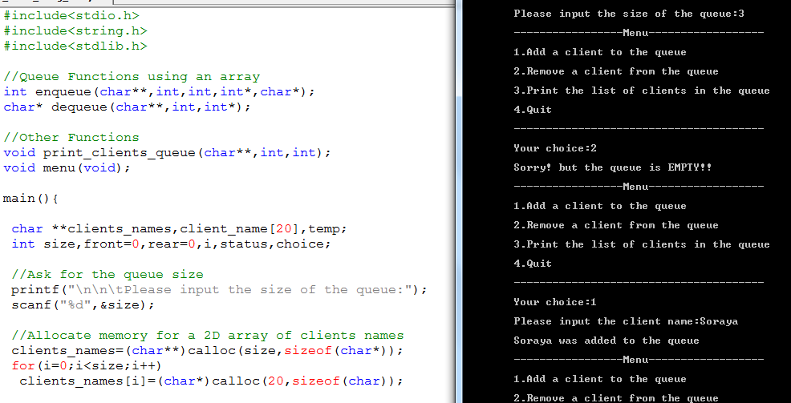
Illustration

Slide 37
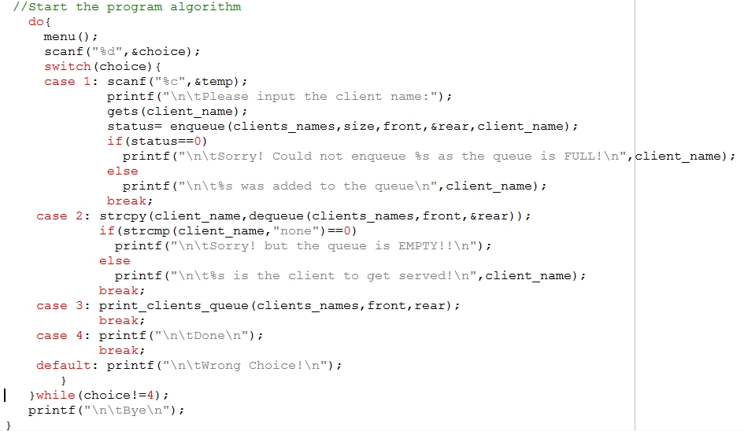

Slide 38
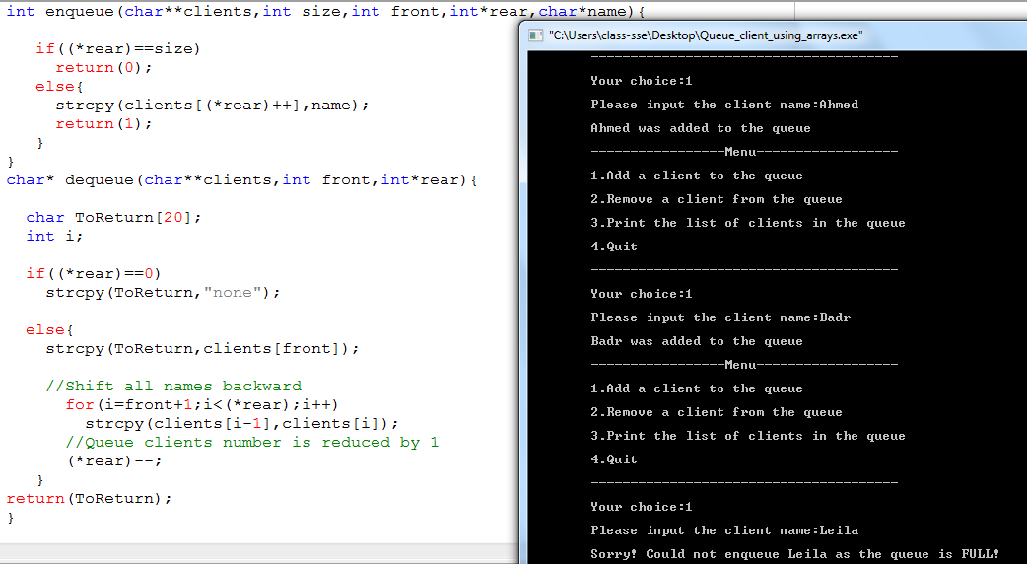

Slide 39
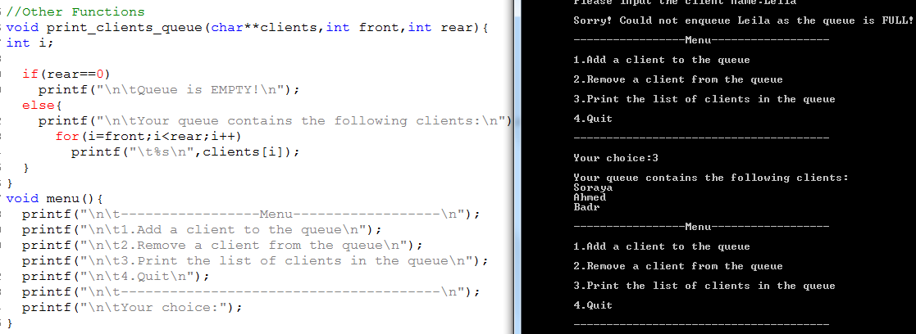

Slide 40
Queue implemented using an array: Drawbacks
Again the drawbacks with the ‘Array Implementation’ are basically the Dynamic Memory Allocation. I.e:
MaxSize has to be guessed
Memory is still there even though elements are dequeued
There is a limit for ‘enqueing’ which depends on the size of the queue!

Slide 41
Queues: implemented using a Linked List
Queue Functions
void enqueue(node **, element*)
element* dequeue(node **);

Slide 42
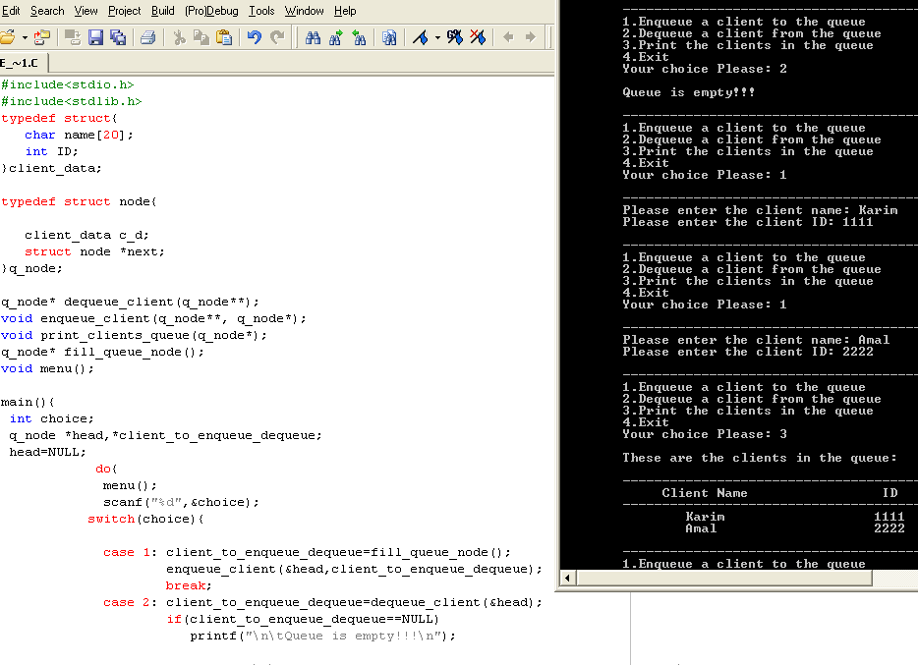

Slide 43
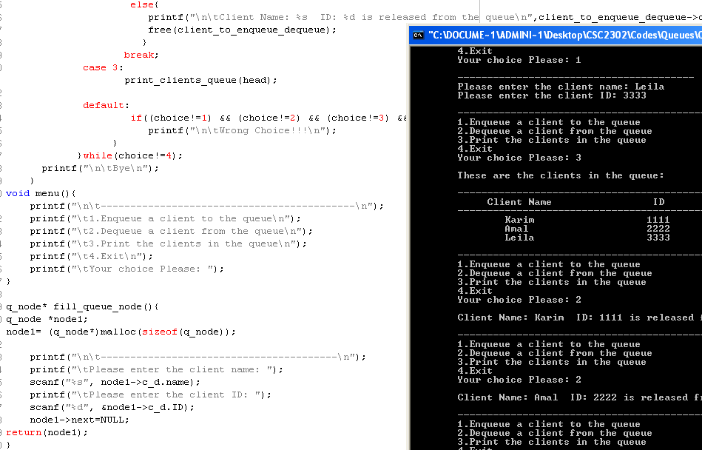

Slide 44
